Slide 1

INDIAN PREMIER LEAGUE (IPL)
VAIBHAV RAJ SAHNI 2K19/CO/419

Slide 2
INTRODUCTION
The Indian Premier League (IPL) is a professional Twenty20 Cricket league in India usually contested between March and May of every year by eight teams representing eight different cities or states in India. The league was founded by the Board of Control for Cricket in India (BCCI) in 2007 and its first season was played in 2008. Ever since then, 13 seasons of IPL have been played and its elaborate ball-by-ball data amounts to a whole database system. In this project, I will build a MySQL database using dataset taken from Kaggle.com. The dataset consists of 6 compressed comma-separated-value (*.csv) files that are downloaded from the same.

Slide 3
OBJECTIVES
Understand the data in the IPL dataset
Design a relational database and store the IPL data in it
Model the database using an Entity-Relationship (ER) diagram
Create its corresponding schema
Create MySQL database
Load data into the database
Add primary and foreign key constraints
Practice various SQL queries on the database

Slide 4
WORK DONE TILL 1ST PREVIEW
Storing the data collected into the database
Understanding the data
Creating an ER diagram for the database

Slide 5
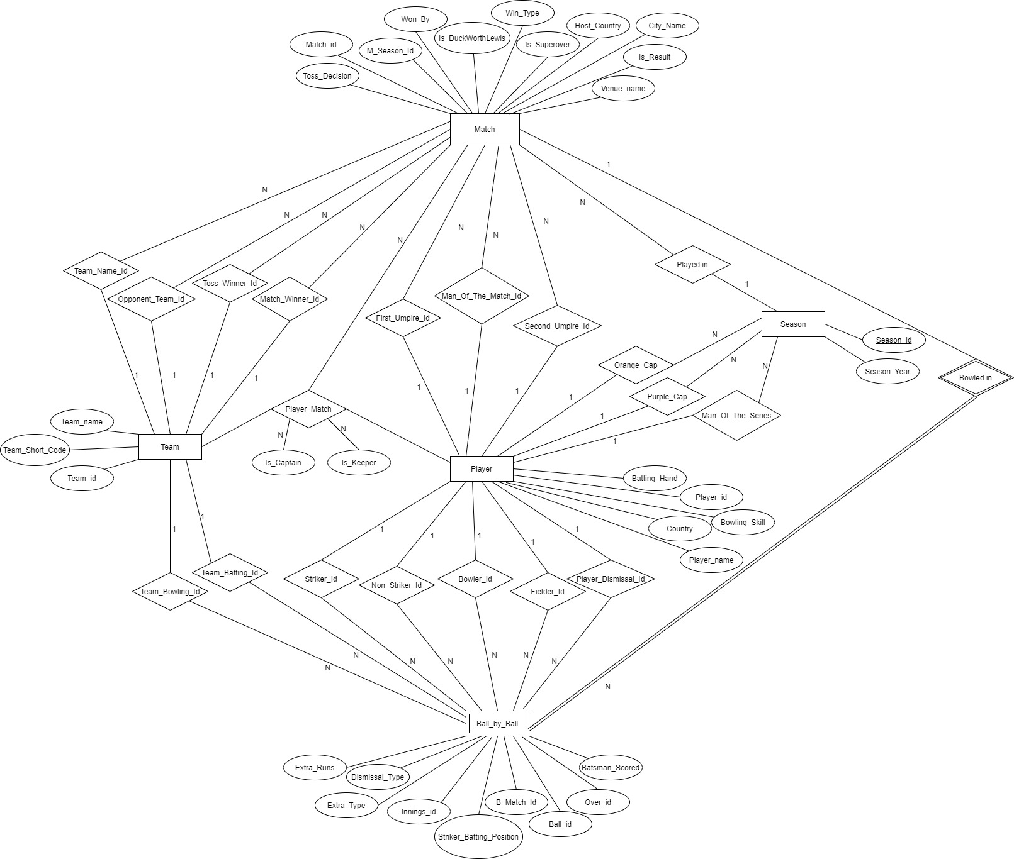
ENTITY-RELATIONSHIP DIAGRAM

Slide 6
WORK DONE AFTER 1ST PREVIEW
Created a schema for the database
Created the database in MySQL Workbench
Imported data files using import data wizard in MySQL Workbench
Changed all the null integer values in the data to 0 using python script
Added Primary Key and Foreign Key constraints

Slide 7
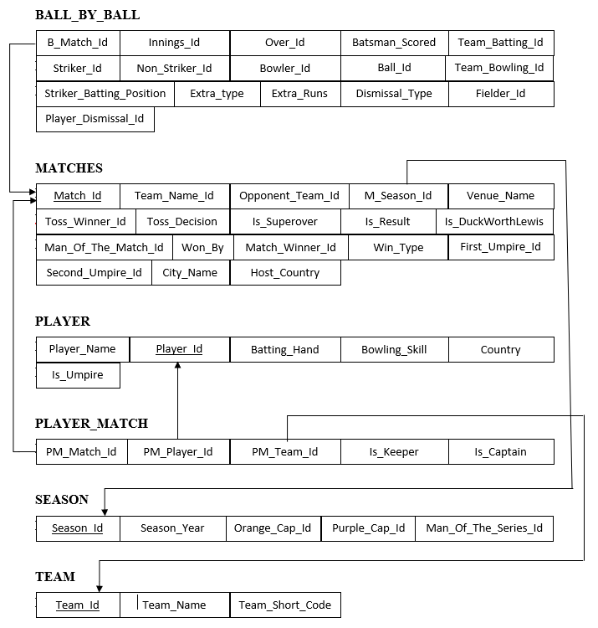
SCHEMA

Slide 8
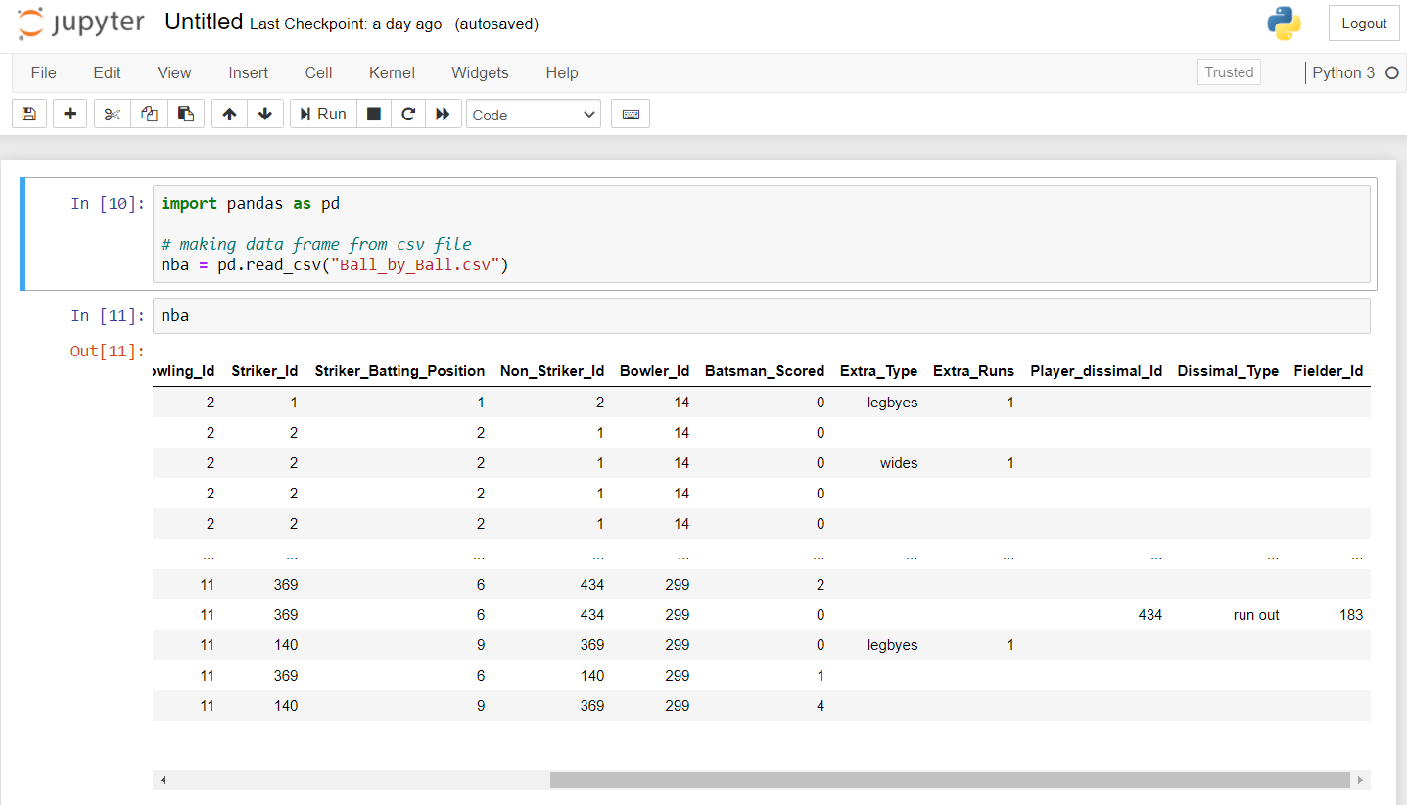
PRE-PROCESSING DATA
Space stored in place of an integer value
BEFORE

Slide 9
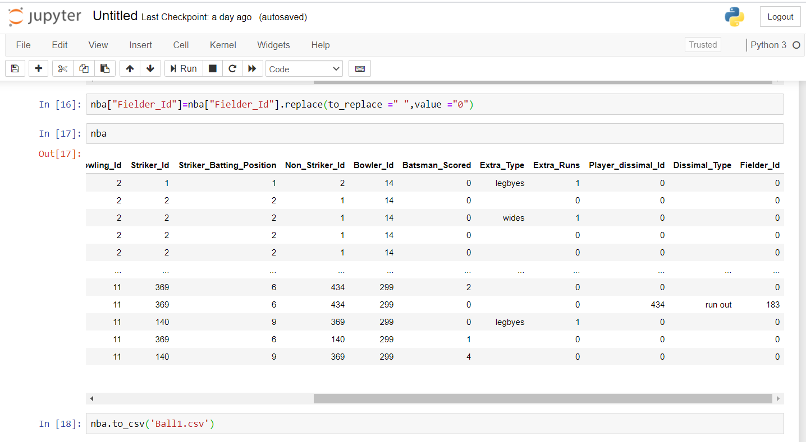
Blank space changed to value 0, which is an integer
AFTER

Slide 10
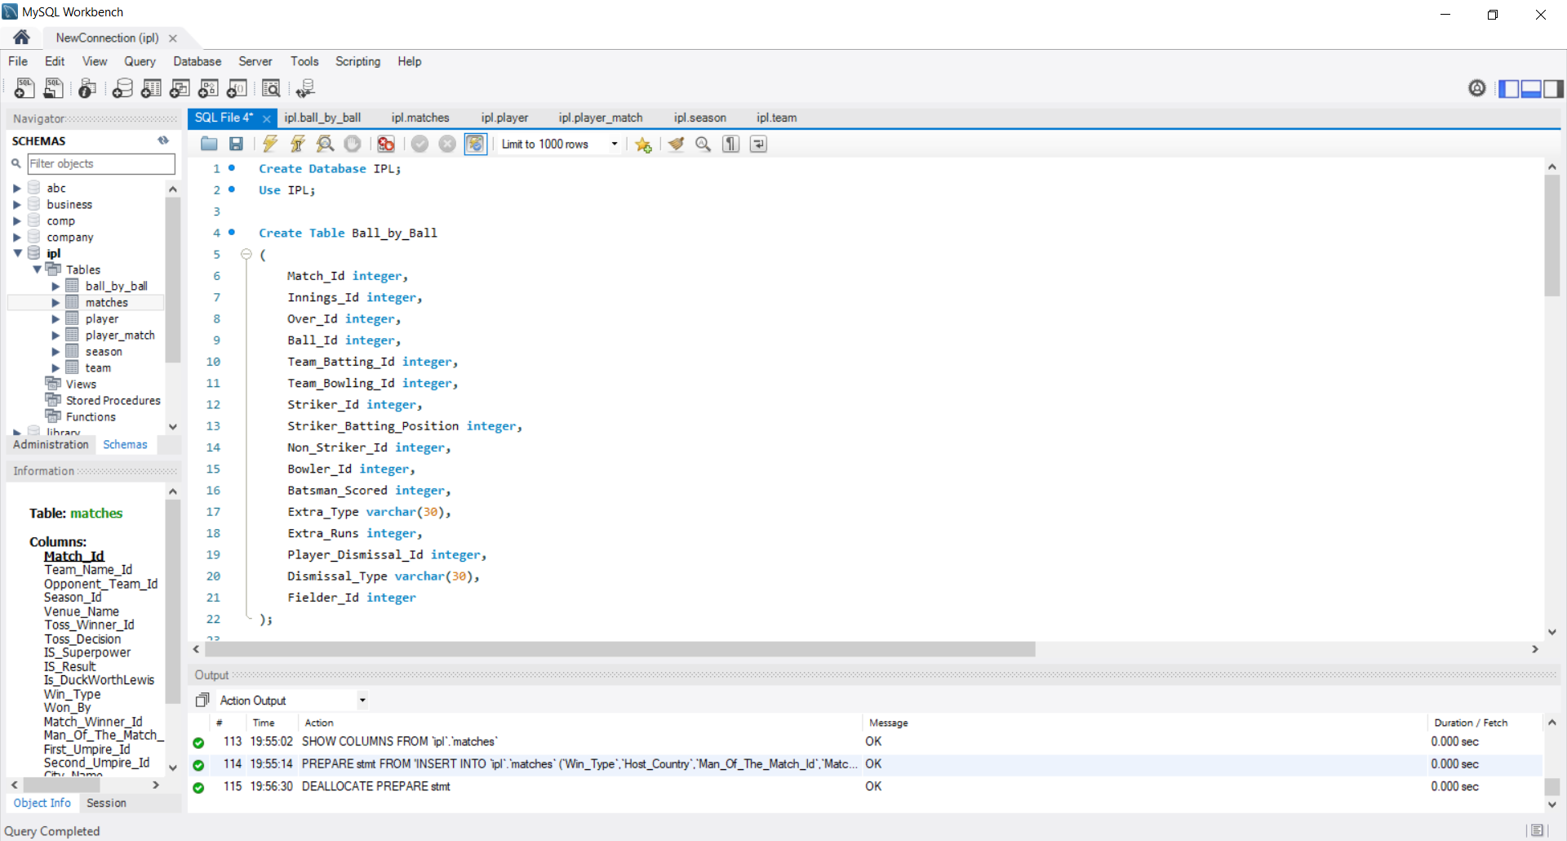
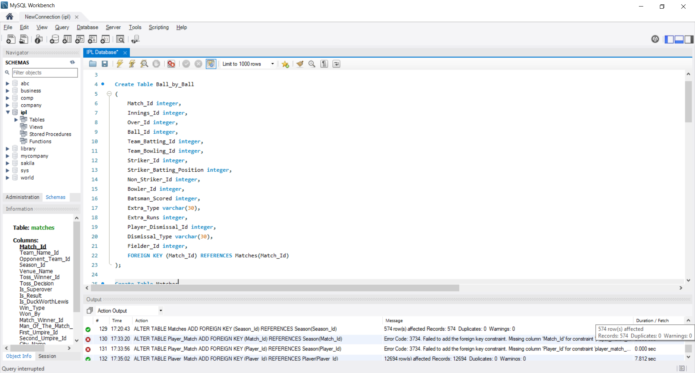
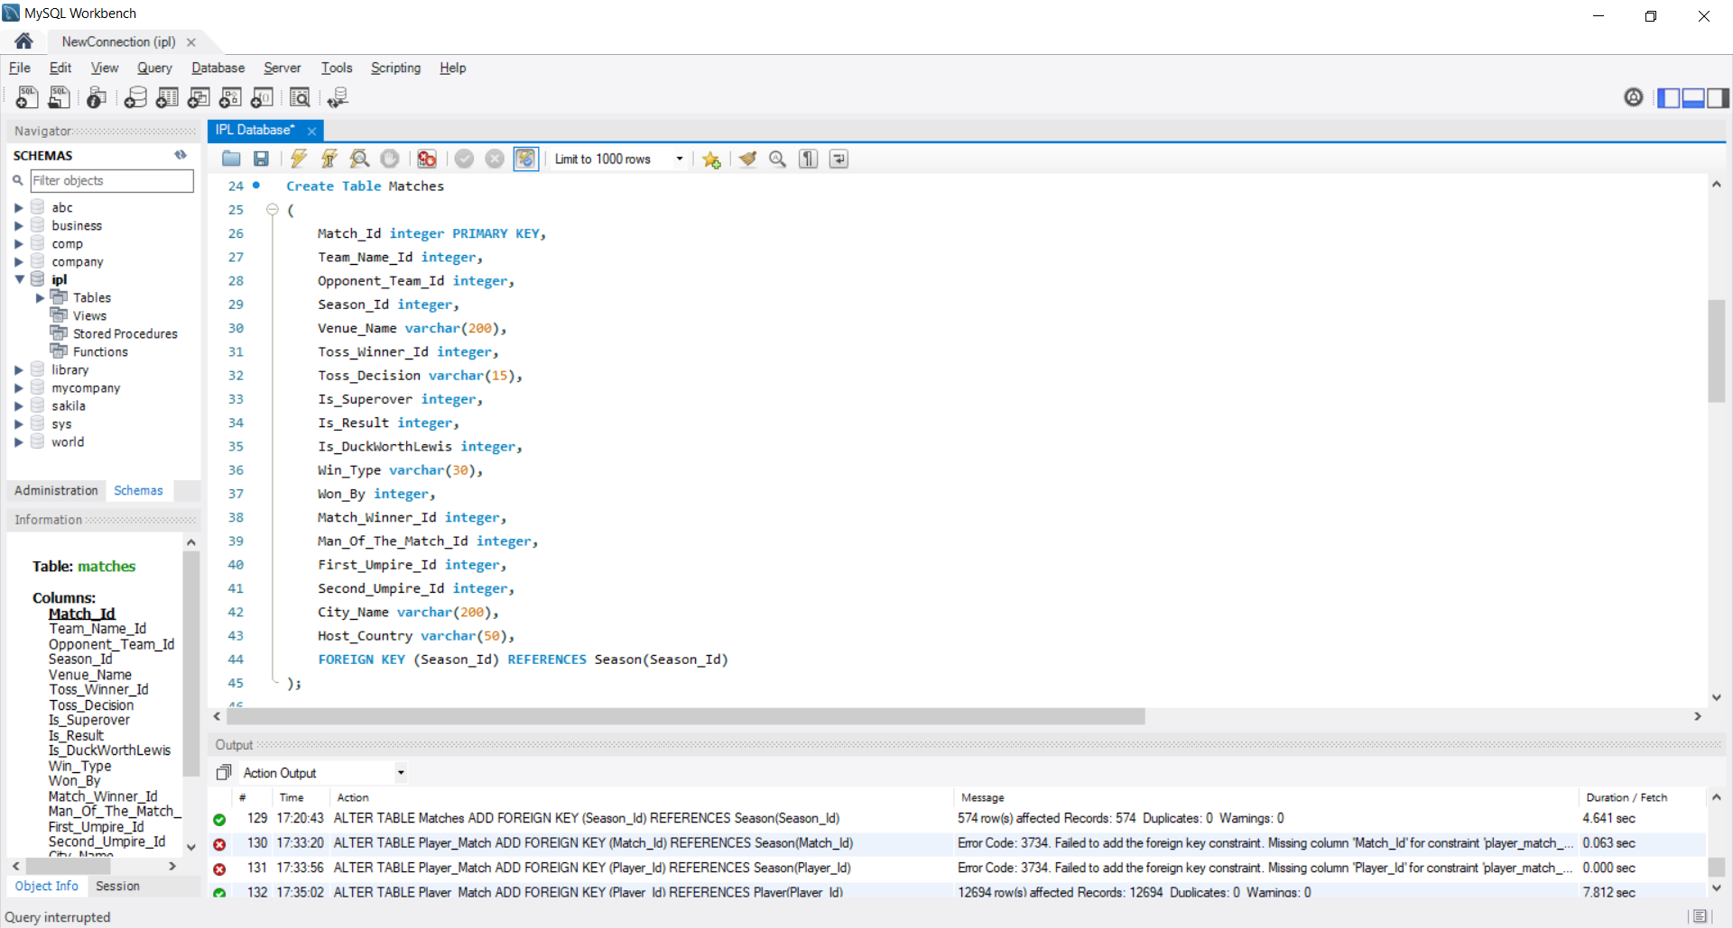
CREATING DATABASE
CREATING TABLES :
Ball_by_Ball
Matches
Player
Player_Match
Season
Team

Slide 11
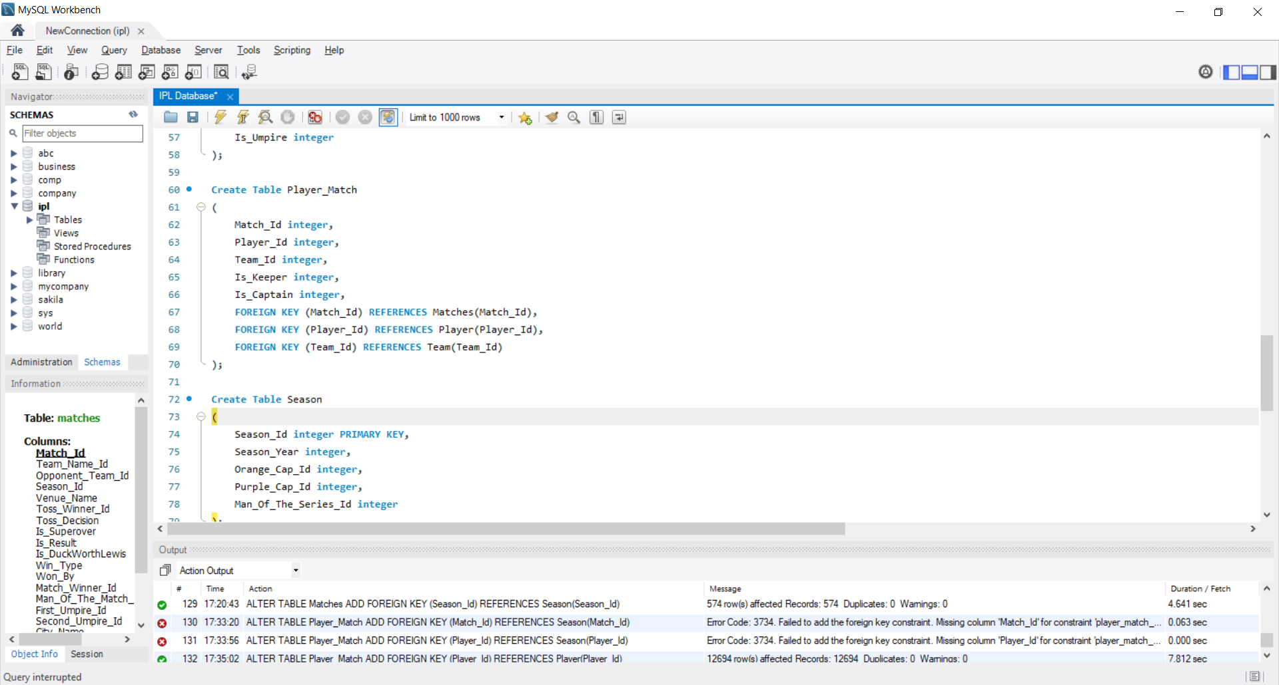
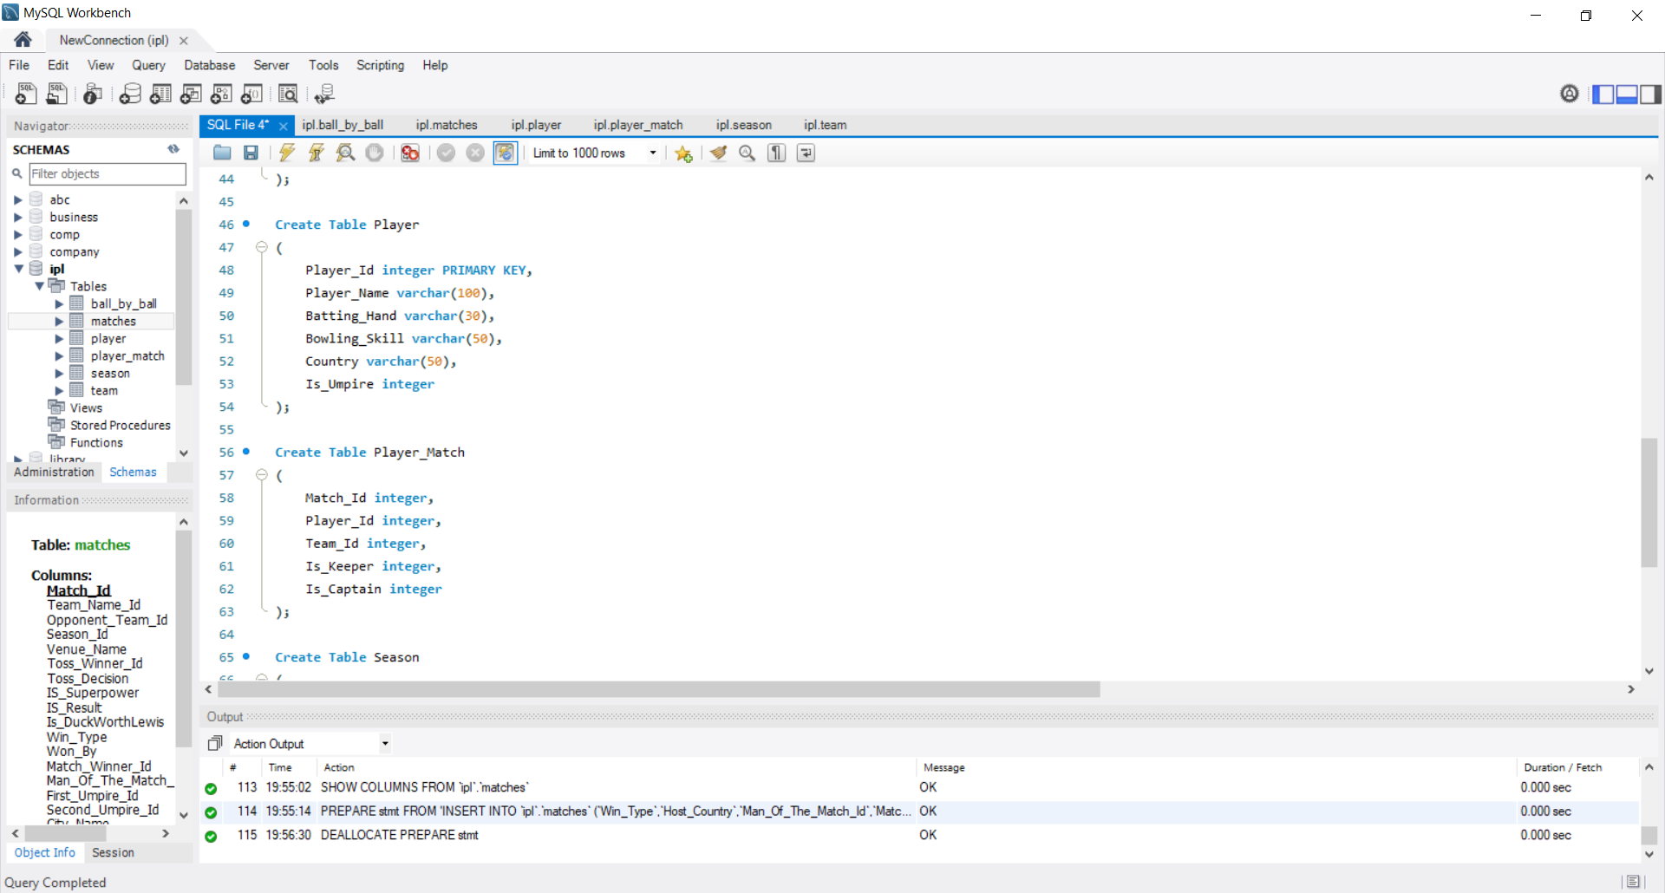
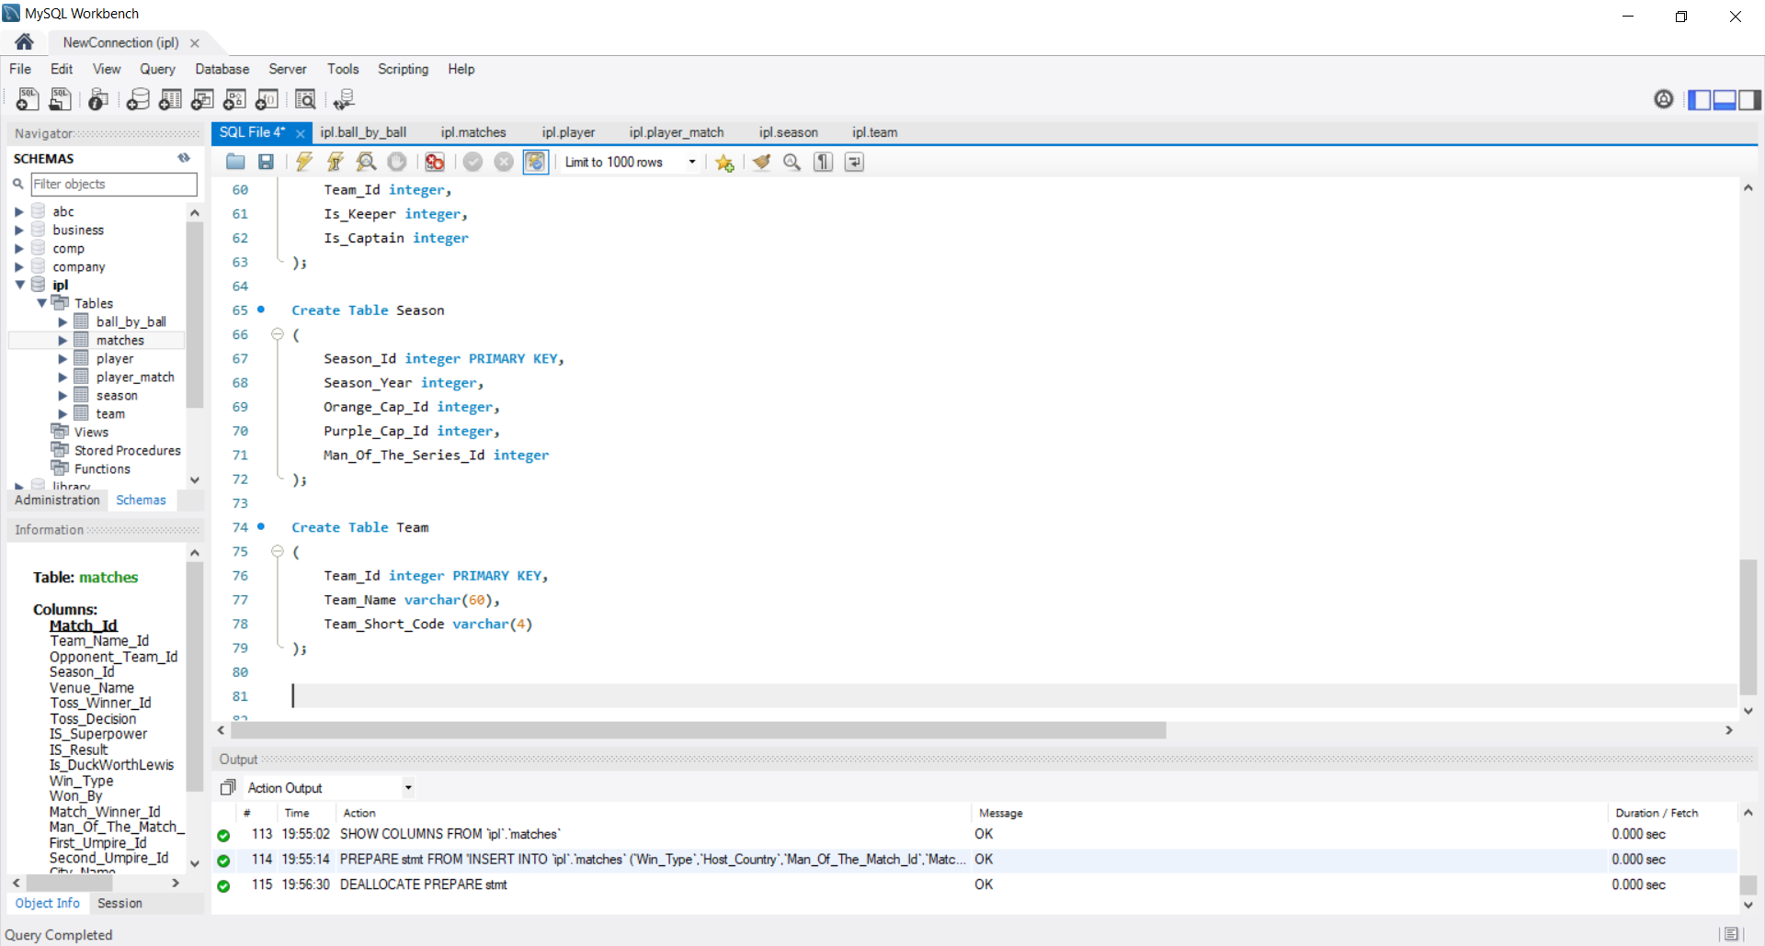
TABLES

Slide 12
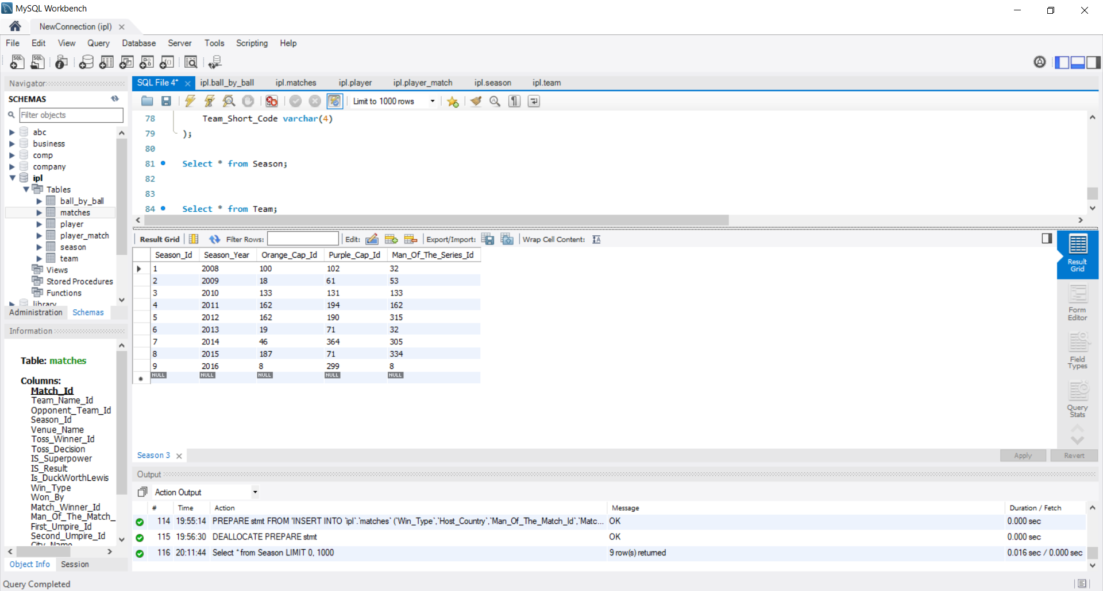
TABLE SHOWING SEASON DETAILS

Slide 13
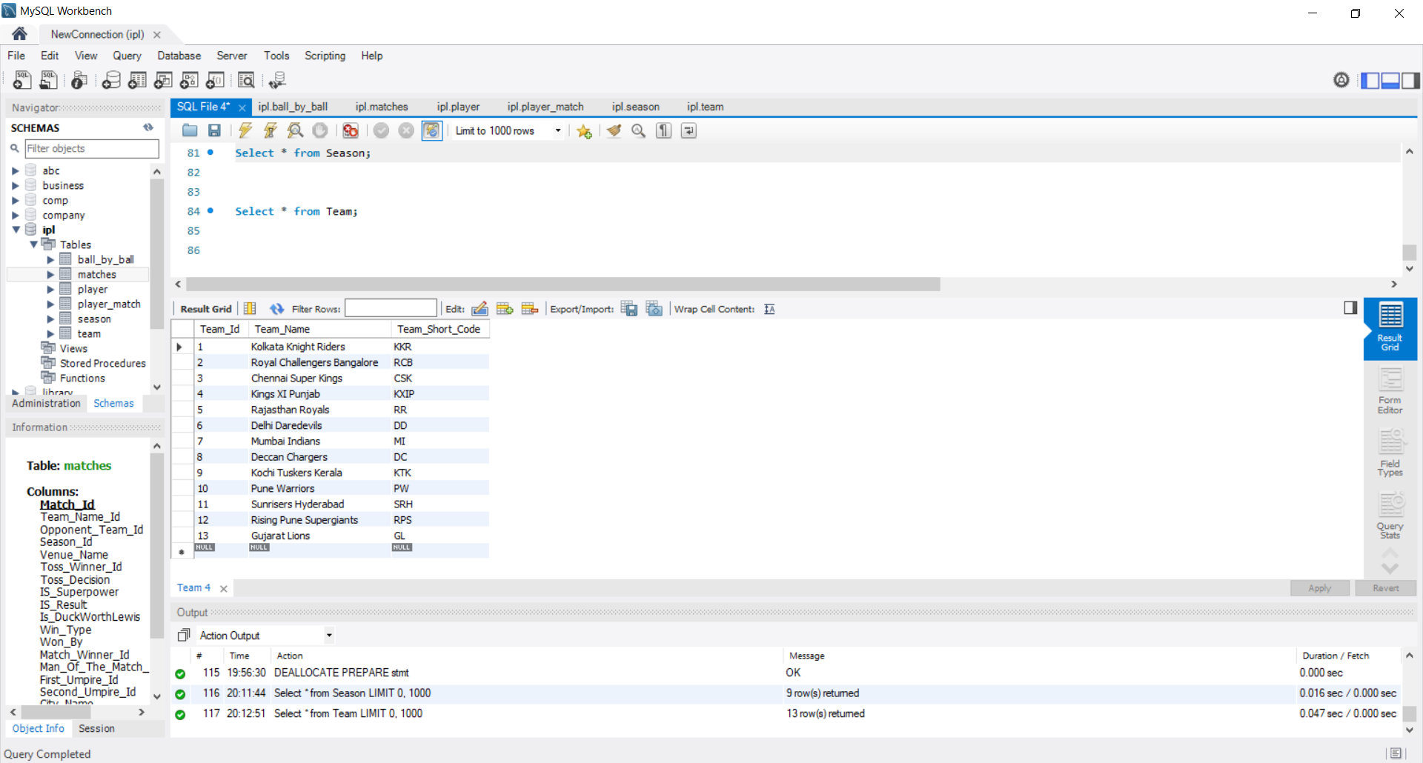
TABLE SHOWING TEAMS

Slide 14
WORK DONE AFTER 2nd PREVIEW
Executed the following queries:
How many matches of the IPL have been hosted by which countries?
How many players from each country have played in the IPL?
Name all the players who have opened the batting for the “Chennai Super Kings”.
What is the total number of players that each team has recruited?
Name all the players and their score who have scored a century.
List the bowlers in the descending order of the number of wickets they have taken.
Create a view and answer the following:
Name the player who has played the maximum number of matches along with the count.
What is the number of matches played by Chris Gayle?
Create a view and answer the following:
List the highest scores of all the batsmen.
What is Mahendra Singh Dhoni’s highest score?

Slide 15
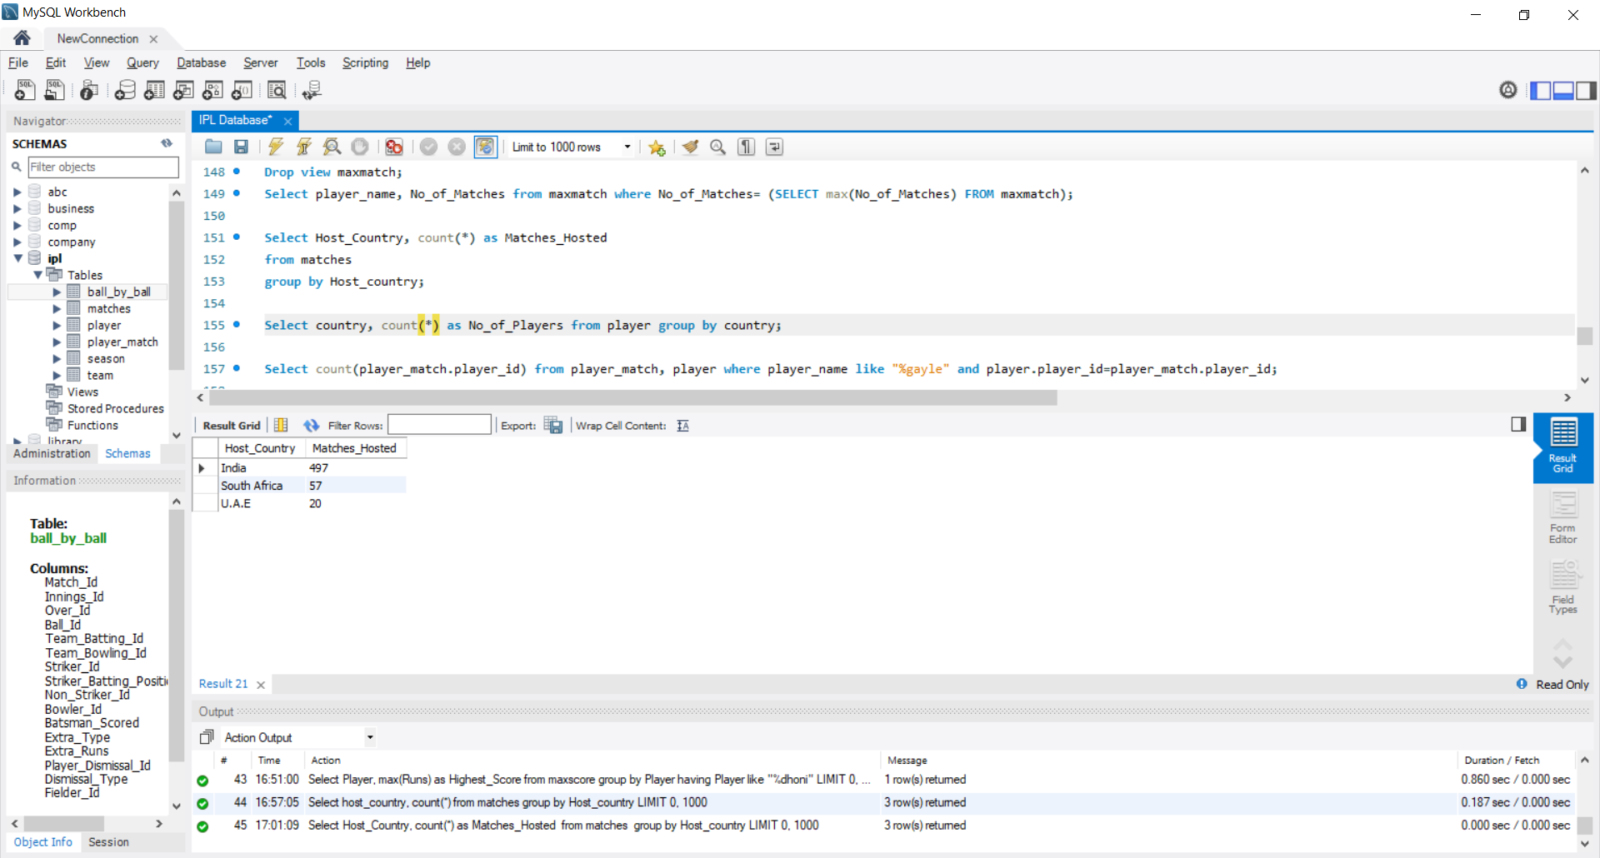
HOST COUNTRY
How many matches of the IPL have been hosted by which countries?
OUTPUT

Slide 16
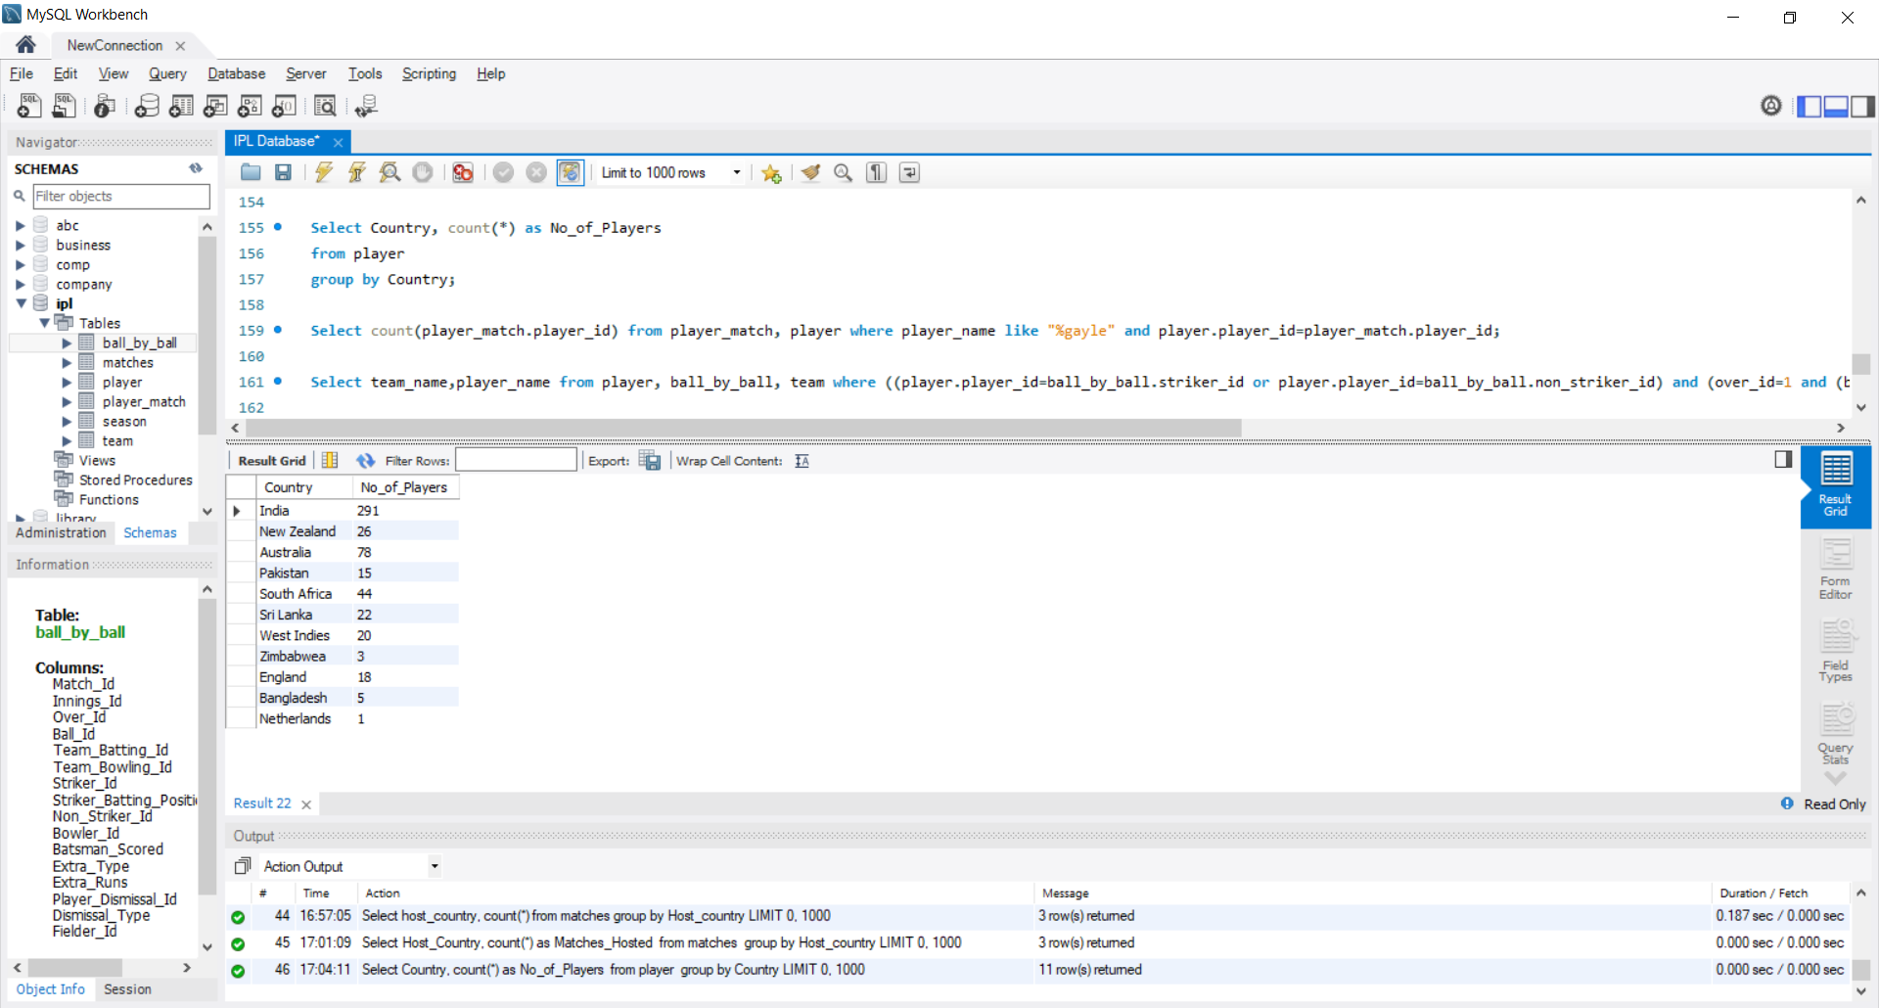
PLAYERS FROM EACH COUNTRY
OUTPUT
How many players from each country have played in the IPL?

Slide 17
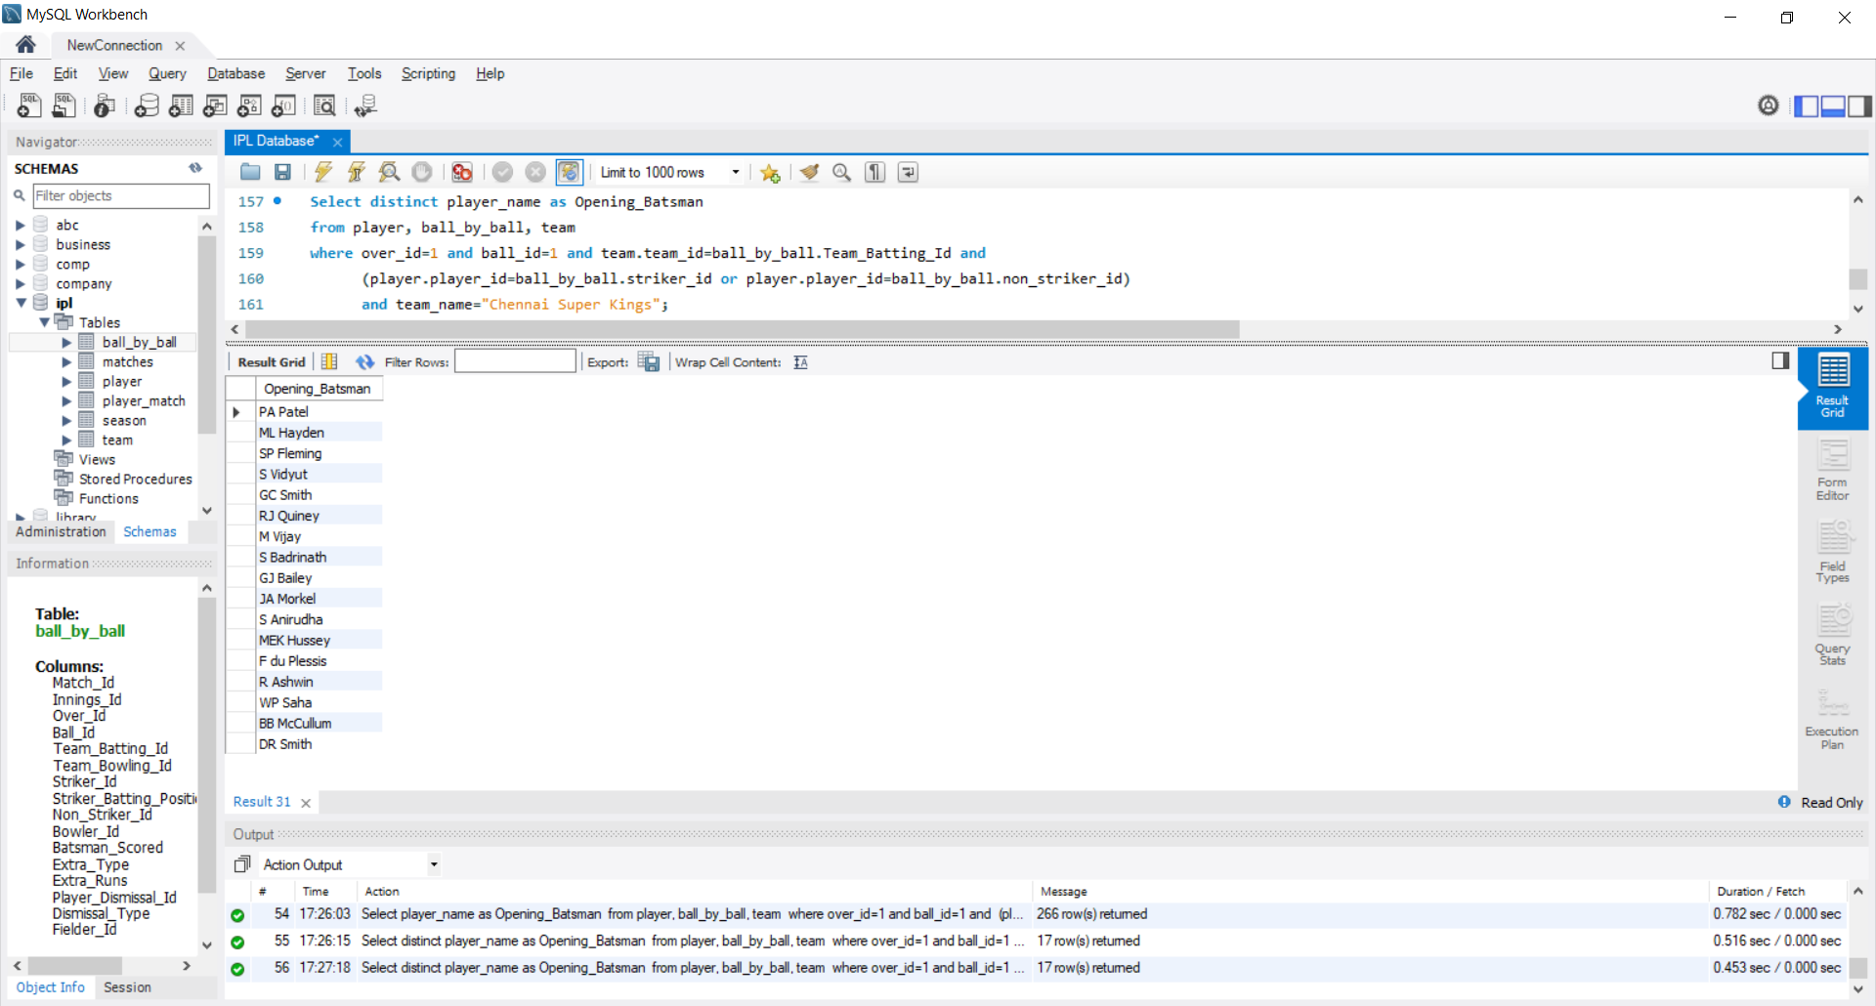
OPENERS FOR CSK
OUTPUT
Name all the players who have opened the batting for the “Chennai Super Kings”.

Slide 18
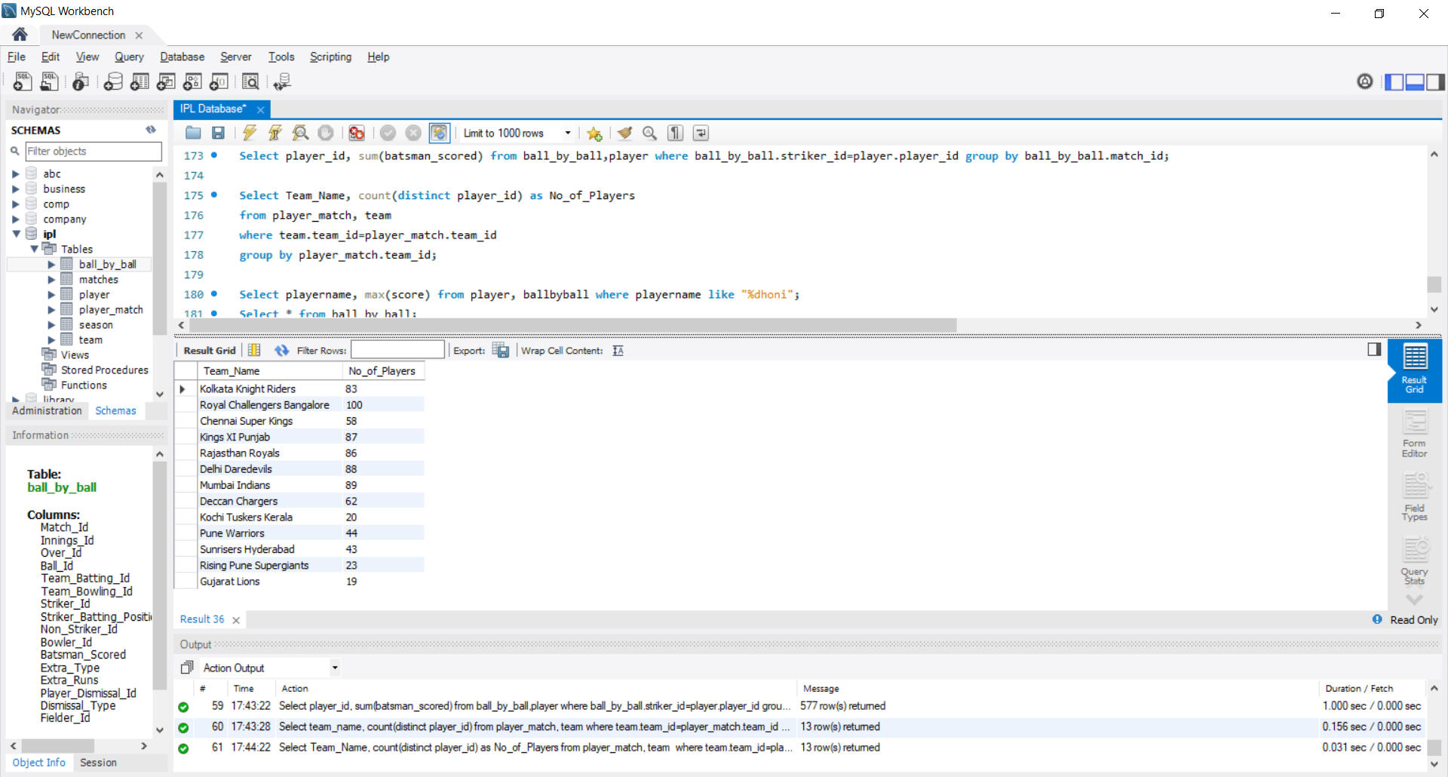
TOTAL PLAYERS
What is the total number of players that each team has recruited?
OUTPUT

Slide 19
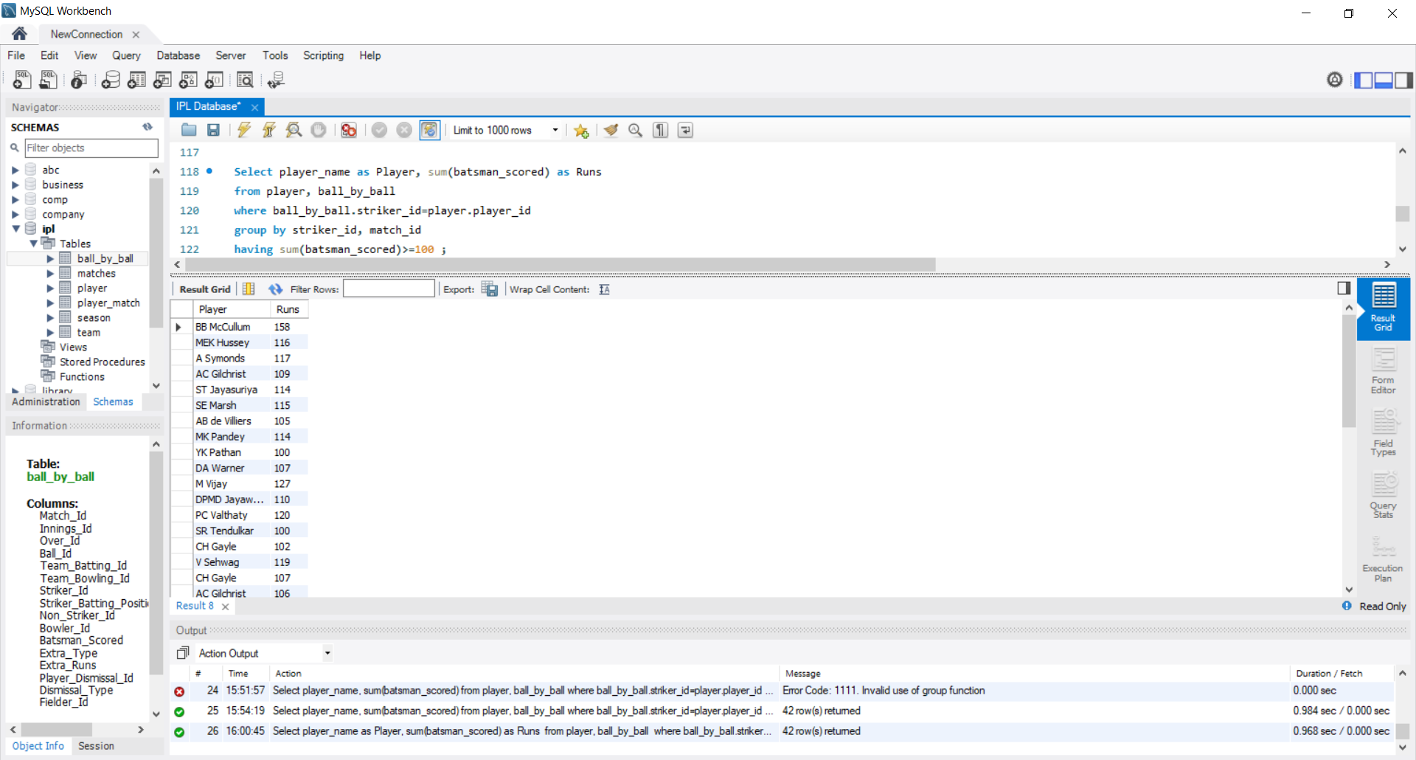
LIST OF CENTURIONS
OUTPUT
Name all the players and their score who have scored a century

Slide 20
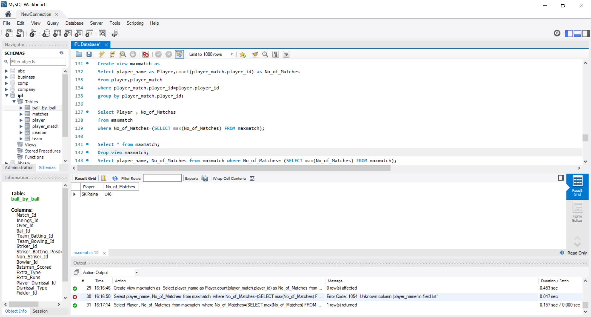
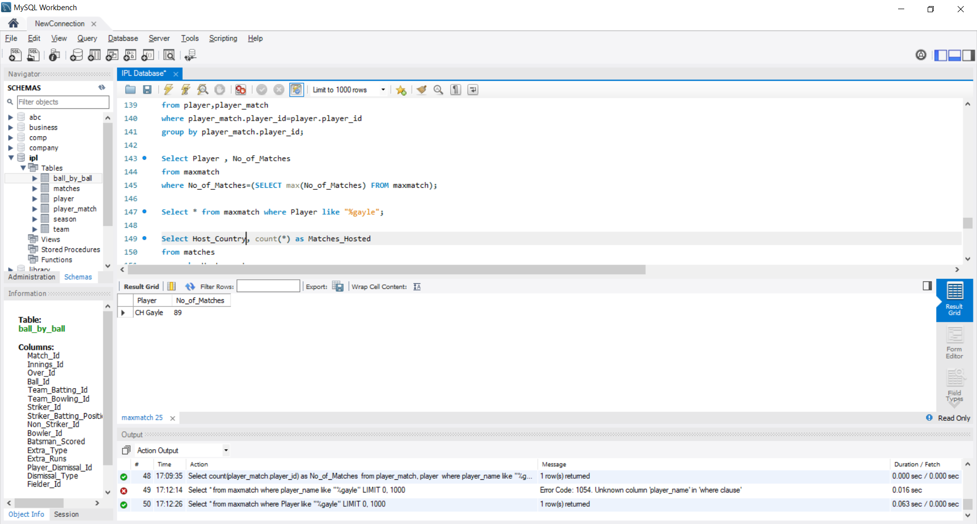
NUMBER OF MATCHES PLAYED
Query 1: Name the player who has played the maximum number of matches along with the count.
OUTPUT 1
Query 2: What is the number of matches played by Chris Gayle?
OUTPUT 2

Slide 21
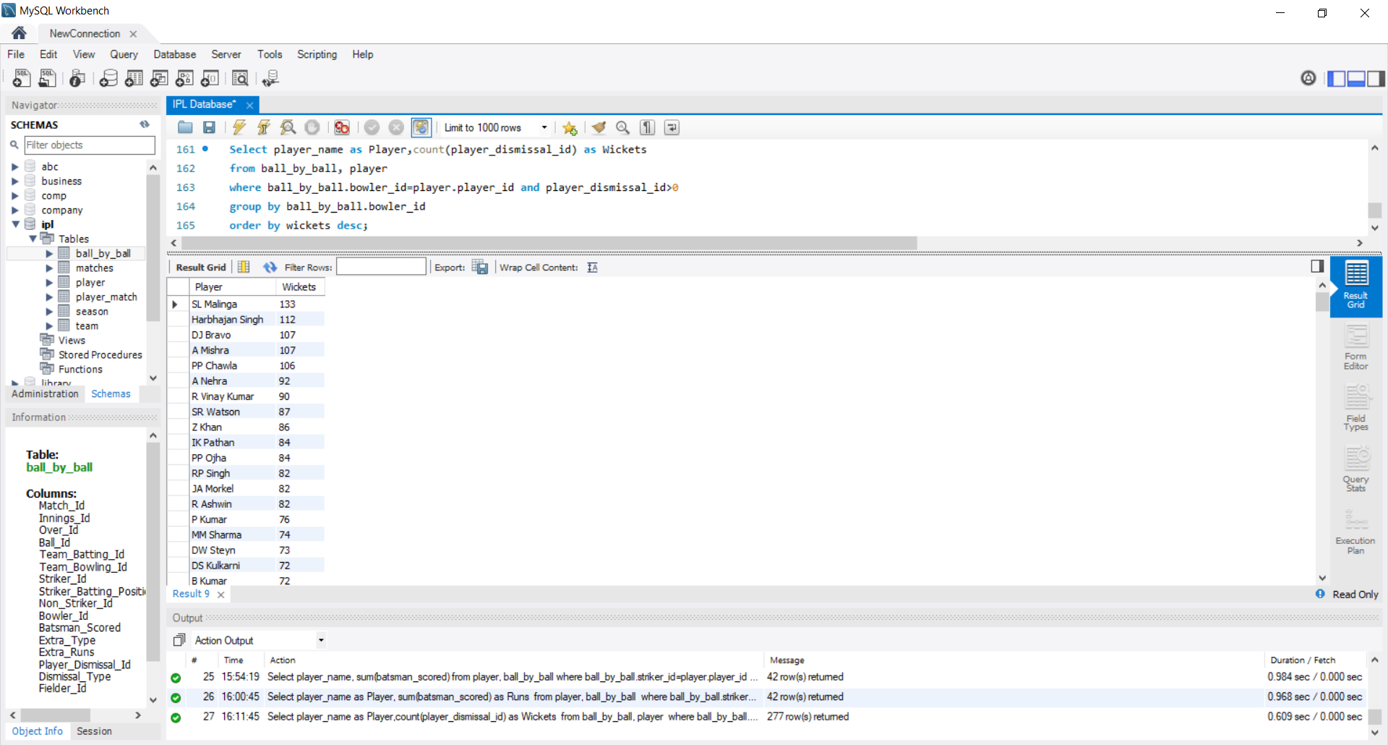
LEADING WICKET TAKERS
OUTPUT
List the bowlers in the descending order of the number of wickets they have taken.

Slide 22
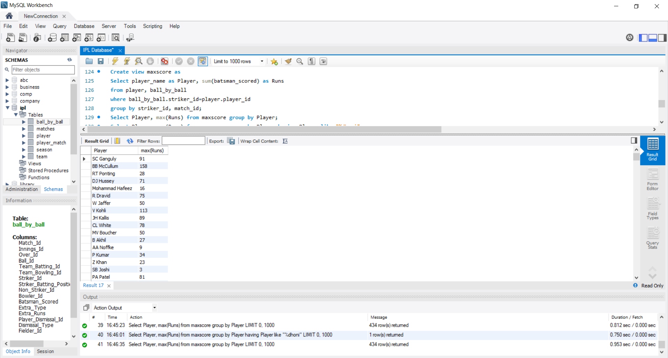
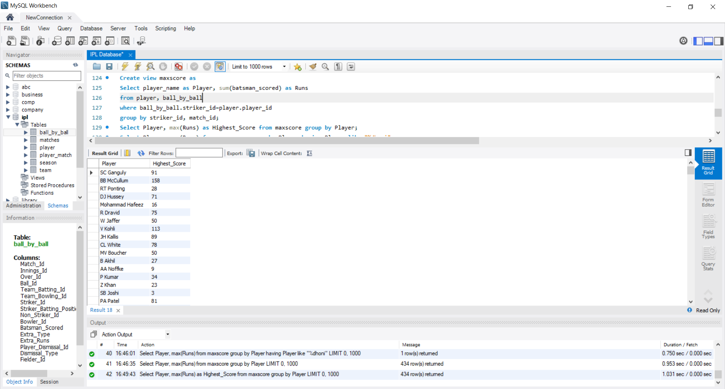
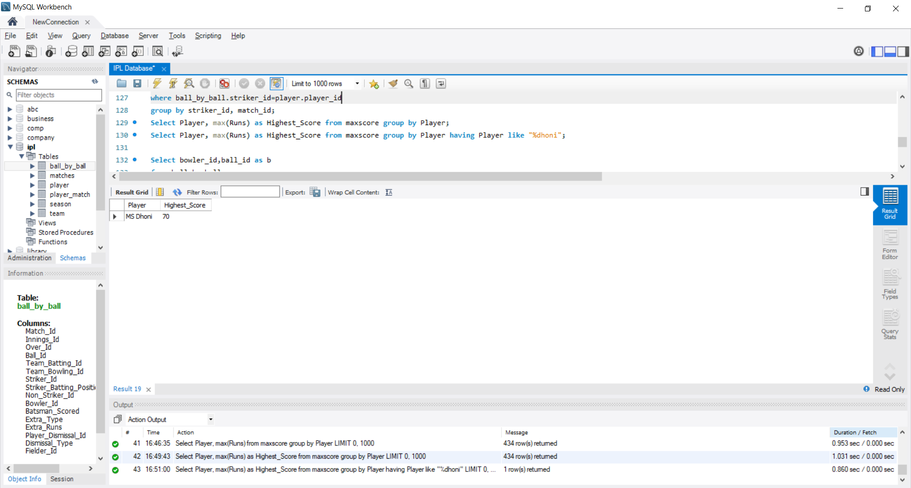
HIGHEST SCORE
OUTPUT 1
Query 1: List the highest scores of all the batsmen
Query 2: What is Mahendra Singh Dhoni’s highest score?
OUTPUT 2

Slide 23
REFERENCES
https://www.kaggle.com/harsha547/indian-premier-league-csv-dataset for dataset
https://app.diagrams.net/ for making an Entity-Relation Diagram
https://docs.python.org/3/ for pre-processing data
www.stackoverflow.com for query formation

Slide 24
THANK YOU

